Slide 1
INVENTORY SUPPLY CHAIN MANAGEMENT
Power BI End-to-End Project
Presented by:
Indhumathi S

Slide 2


Business Challenges & Strategic Objectives
Business Challenges
Strategic Objectives
No clear visibility on sales trends
Shipping delays impacting customer satisfaction
High late delivery risk by product/category
Poor inventory & demand alignment
Hard to identify top vs low performing products
Track monthly sales & profit trends
Identify delay-prone products & categories
Monitor late delivery %
Improve supply chain efficiency
Support data-driven decisions

Slide 3
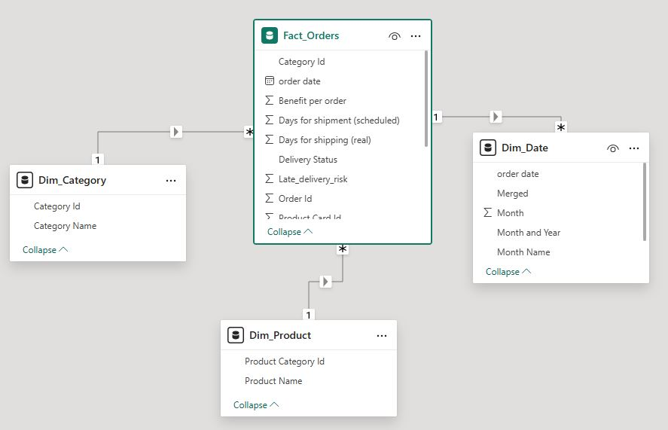
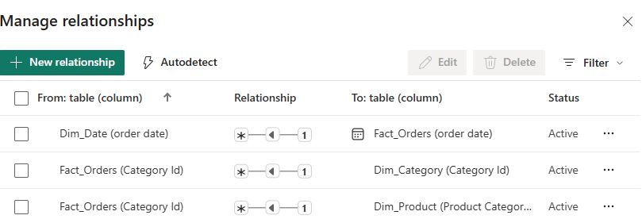
Dataset Overview
Star Schema
One-to-Many Relationships
Central Fact table with supporting Dimension tables
📁 Data Model Structure
🗂️Tables Used
Fact_Orders
Dim_Products
Dim_Category
Dim_Date
🔗 Relationships
Dim_Products (1) → Fact_Orders (Many)
Dim_Category (1) → Fact_Orders (Many)
Dim_Date (1) → Fact_Orders (Many)
Analyze Sales & Profit trends
Track Shipping performance & delays
Identify Late Delivery risk by Product & Category
Support monthly & yearly business insights
🎯 Purpose of Dataset

Slide 4
️ Power Query Editor – Data Preparation
🎯 Purpose
Clean & prepare raw data before modeling
Fix data types to avoid DAX errors
Create usable columns for analysis
🛠️Key Transformations Used
Removed Columns – dropped unwanted fields
Changed Data Types – Sales/Profit → Decimal, Dates → Date
Split Columns – Date → Year, Month
Merge Queries – Fact_Orders with Dim tables (Keys)
Append Queries – combine similar datasets (if needed)
01
02
04
📅 Date Handling
Extracted Year, Month, Month-Year
Created proper Dim_Date table
Linked Order Date to Dim_Date
05
03
📌 Outcome
Error-free model
Correct One-to-Many relationships
Faster reports & accurate visuals
🧹 Data Cleaning
Removed blanks & null values
Fixed text → number conversion
Standardized Product & Category names

Slide 5
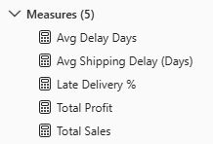
Key DAX Measures
01
Avg Delay Days
Avg Delay Days = AVERAGEX(Fact_Orders,Fact_Orders[Days for shipping (real)] - Fact_Orders
[Days for shipment (scheduled)])
Purpose:Measures average shipping delay to monitor delivery performance and identify logistics inefficiencies.
02
Avg Shipping Delay (Days)
Avg Shipping Delay (Days) = AVERAGEX(Fact_Orders,
Fact_Orders[Days for shipping (real)] - Fact_Orders[Days for shipment (scheduled)])
Purpose: Measures the average shipping delay to monitor delivery efficiency and improve supply chain performance.
03
Late Delivery %
Late Delivery % = DIVIDE(CALCULATE(COUNTROWS(Fact_Orders), Fact_Orders[Late_delivery_risk] = 1),COUNTROWS(Fact_Orders))
Purpose: Measures the percentage of late deliveries to evaluate delivery performance and identify logistics issues.
04
Total Profit
Purpose: Measures total profit to evaluate business performance and identify profitable products and categories.
Total Profit = SUM(Fact_Orders[Benefit per order])
05
Total Sales
Total Sales = SUM(Fact_Orders[Sales per customer])
Purpose:Measures total sales revenue to monitor business performance and analyze sales trends.

Slide 6
OVERVIEW
📈 Visuals Used
📊 KPIs (Cards)
Clustered Column Chart -Total Sales by Month (Order Date)
Purpose:
Monthly trend
Sales comparison
Performance tracking
Clustered Bar Chart Average Shipping Delay (Days) by Product
Purpose:
Product comparison
Delay identification
Bottleneck detection
100% Stacked Column Chart Late Delivery % by Category
Purpose:
Analyzes revenue trend over time
Identifies growth and decline periods
Supports financial planning and performance tracking.
Clustered Column Chartotal Sales by Category
Purpose:
Category comparison
Revenue contribution
Performance ranking
Total Sales
Purpose:
Revenue snapshot
Overall performance
Business health
Average Shipping Delay (Days)
Purpose:
Delivery efficiency
Delay monitoring
Late Delivery %
Purpose:
Service level
Risk monitoring
Performance quality
🎛 Slicers
Month-Year (Order Date)
Time filter
Period focus
Trend view
Category
Segment filter
Drill-down
Comparison

Slide 7




Supply Chain & Shipping Overview
Clustered Bar Chart
Top 10 Products by Average Shipping Delay (Days)
KPI Card
Average Shipping Delay (Days)
Table
Product Delivery Performance Summary
Slicers
Category
Segment filter
Drill-down
Comparison
Month (Order Date)
Time filter
Period focus
Trend view
Purpose
Top delays
Bottleneck ranking
Priority focus
Purpose
Delivery efficiency
Delay monitoring
Operational KPI
Purpose
Product overview
KPI comparison
Issue spotting

Slide 8



Product Performance
02
Stacked Bar Chart
Total Sales by Product
Purpose
Sales distribution
Product contribution
Compare products
Clustered Column Chart
Total Profit by Product
01
03
Slicers
Category: Segment filter, Focus analysis,
Comparison.
Month (Order Date): Time filter, Period focus ,Trend view.
Purpose
Profit comparison
Product profitability
Top performers

Slide 9




Why This Project? | Value | Impact
🔎 Why I Chose This Project
❗Business Problems
🔧 Improvements After This Project
👥 Who Benefits?
Inventory & Supply Chain is a real business problem
Companies face issues in sales tracking & delivery delays
This project helps to learn end-to-end Power BI (Power Query, Modeling, DAX, Visuals)
Useful for real-time business decision making
No clear visibility of sales and profit trends
Late deliveries not monitored properly
Difficult to identify low-performing products & categories
Manual reports cause slow decision making
Automated monthly sales & profit tracking
Clear monitoring of shipping delay & late delivery %
Easy identification of top & low performing products
Centralized dashboard for quick analysis
Business Management
Supply Chain / Operations Team
Inventory / Warehouse Team
Sales Team

Slide 10
THANK YOU
Open for questions & feedback

